Slide 1


Semantic Web
MESSAOUDI Amin
OZER Mert
Professor: Yue Ma 26/10/2017
Notes:
Hello everyone ...

Slide 2
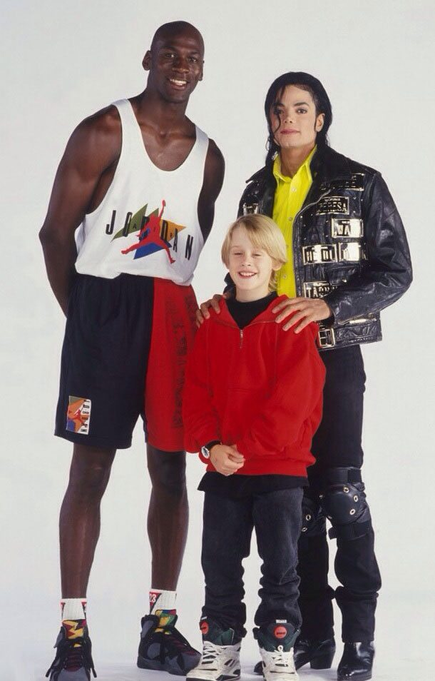
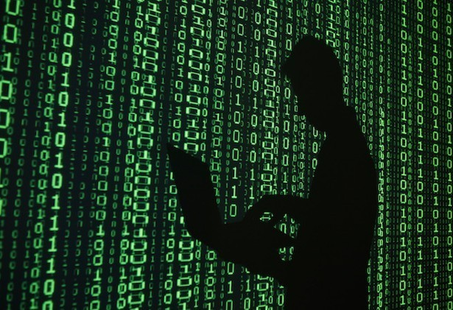
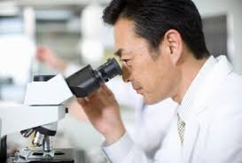
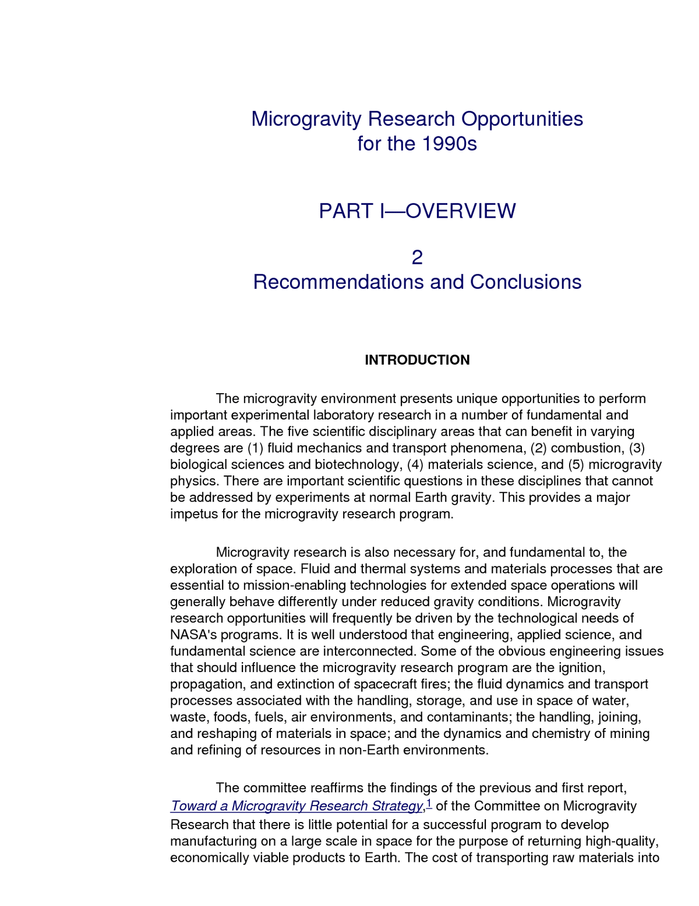
Our Task
“Landmark article on data integration written by a researcher from a Japanese University in the 1990s.”

Slide 3
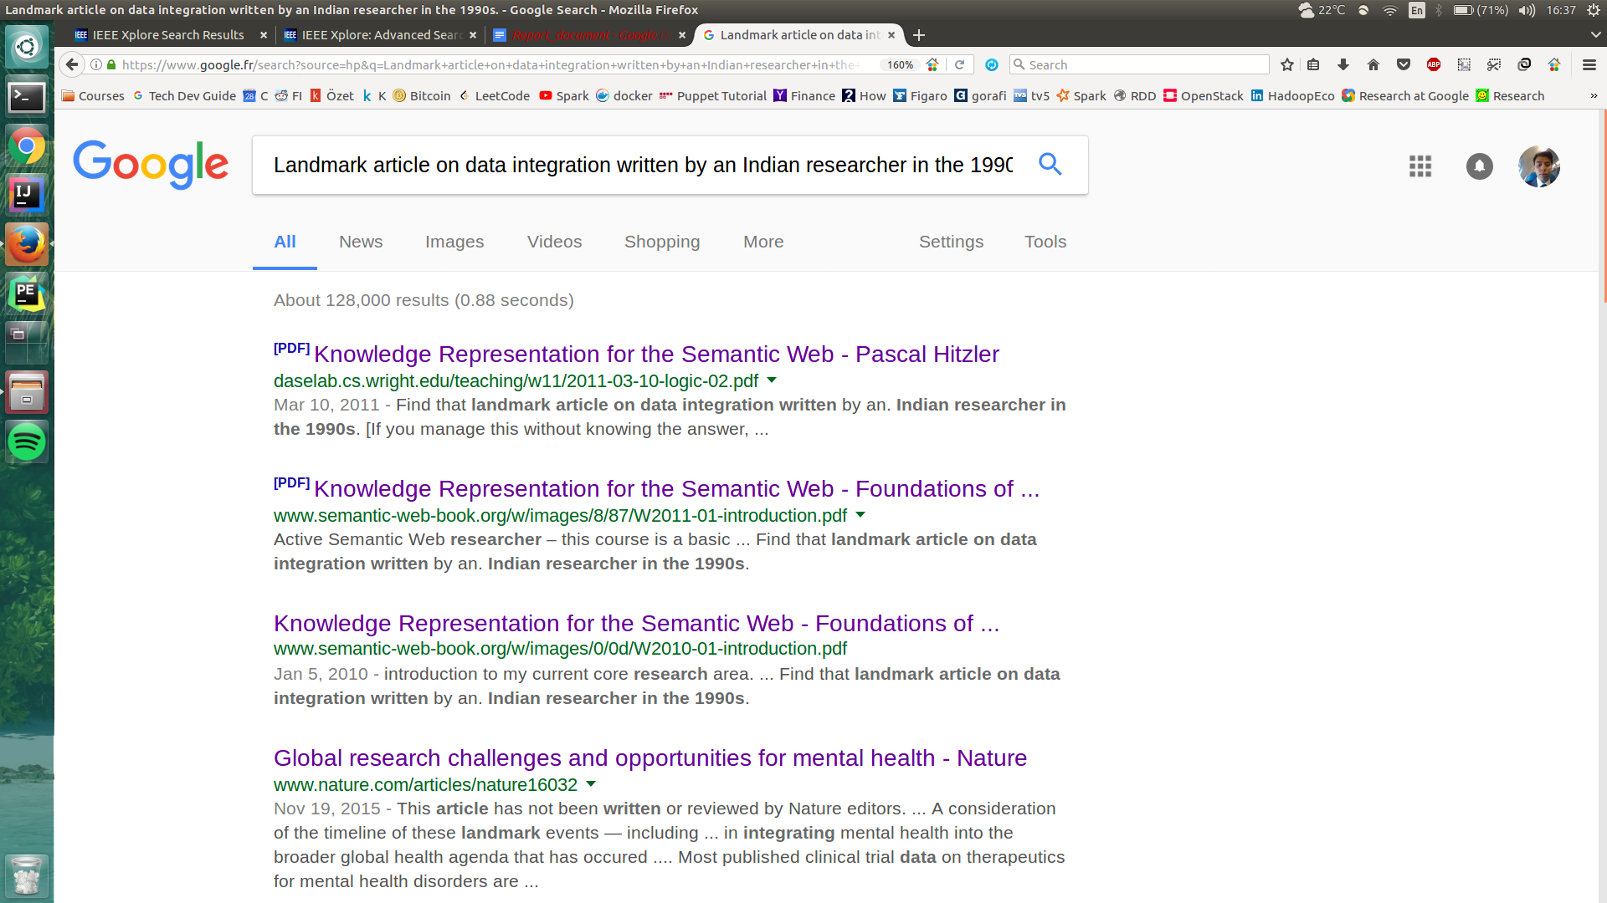
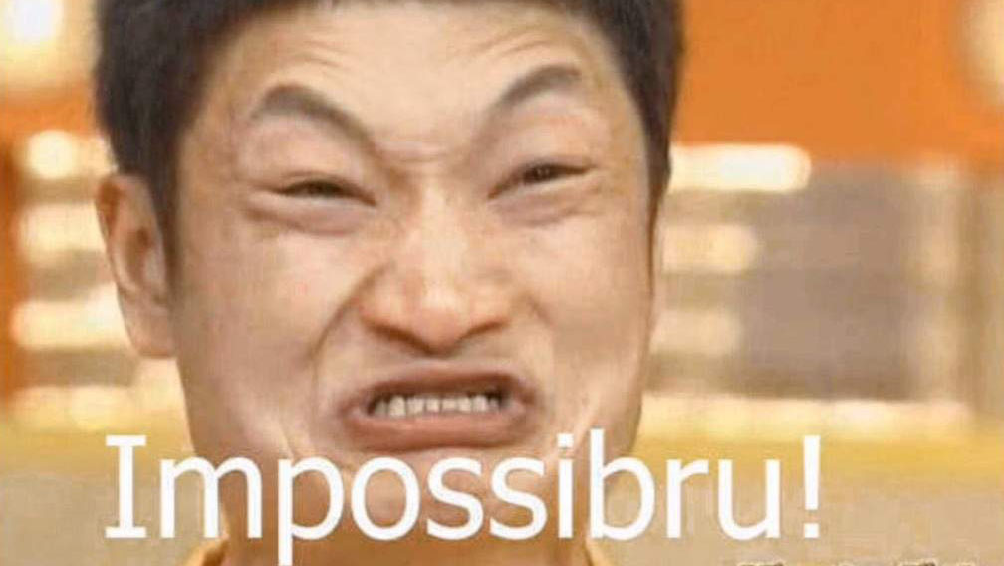
First Try
Notes:
AMIN
First, we tried it on google, to see the answer. We searched over the 2 first pages
As expected no answer given by google. There is some keywords matching but not understanding the question.
We can ask ourselves why google is not finding the answer ?

Slide 4
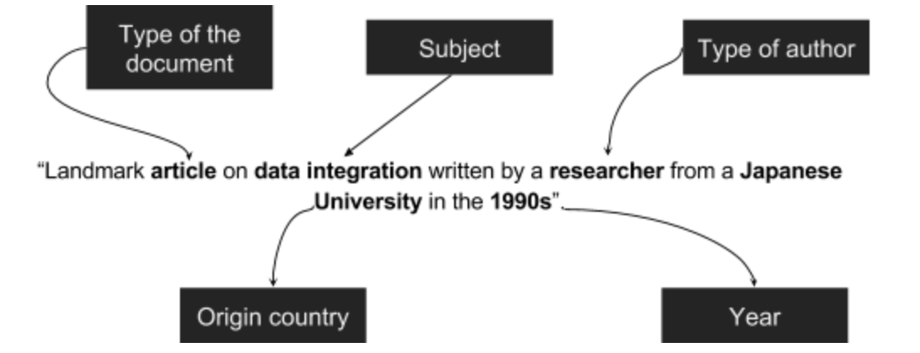
Analyze Task
Several parameters needs to be handled here, that’s why to task is complicated for google.
Notes:
AMIN
First of all, the task has several parameter, which are document …
Google is not able to understand that much of parameters

Slide 5
How to find the result?
Manual
Automatic
Notes:
So, how to find the result then ?
1 st way is manual, 2 nd is “automatic” one
What do we mean by manual search => transition next slide

Slide 6
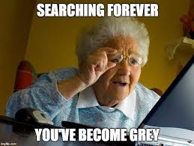
Manual Search
Notes:
With Manual search, theorically it is possible to find the answer, but how long it will take 1h, 1week we don’t know
We have tried several website containing publication, like IEEE, google scholar, dblp but each of them have it’s way to search
Result, has it feature.
It is like impossible to find it in few minutes

Slide 7
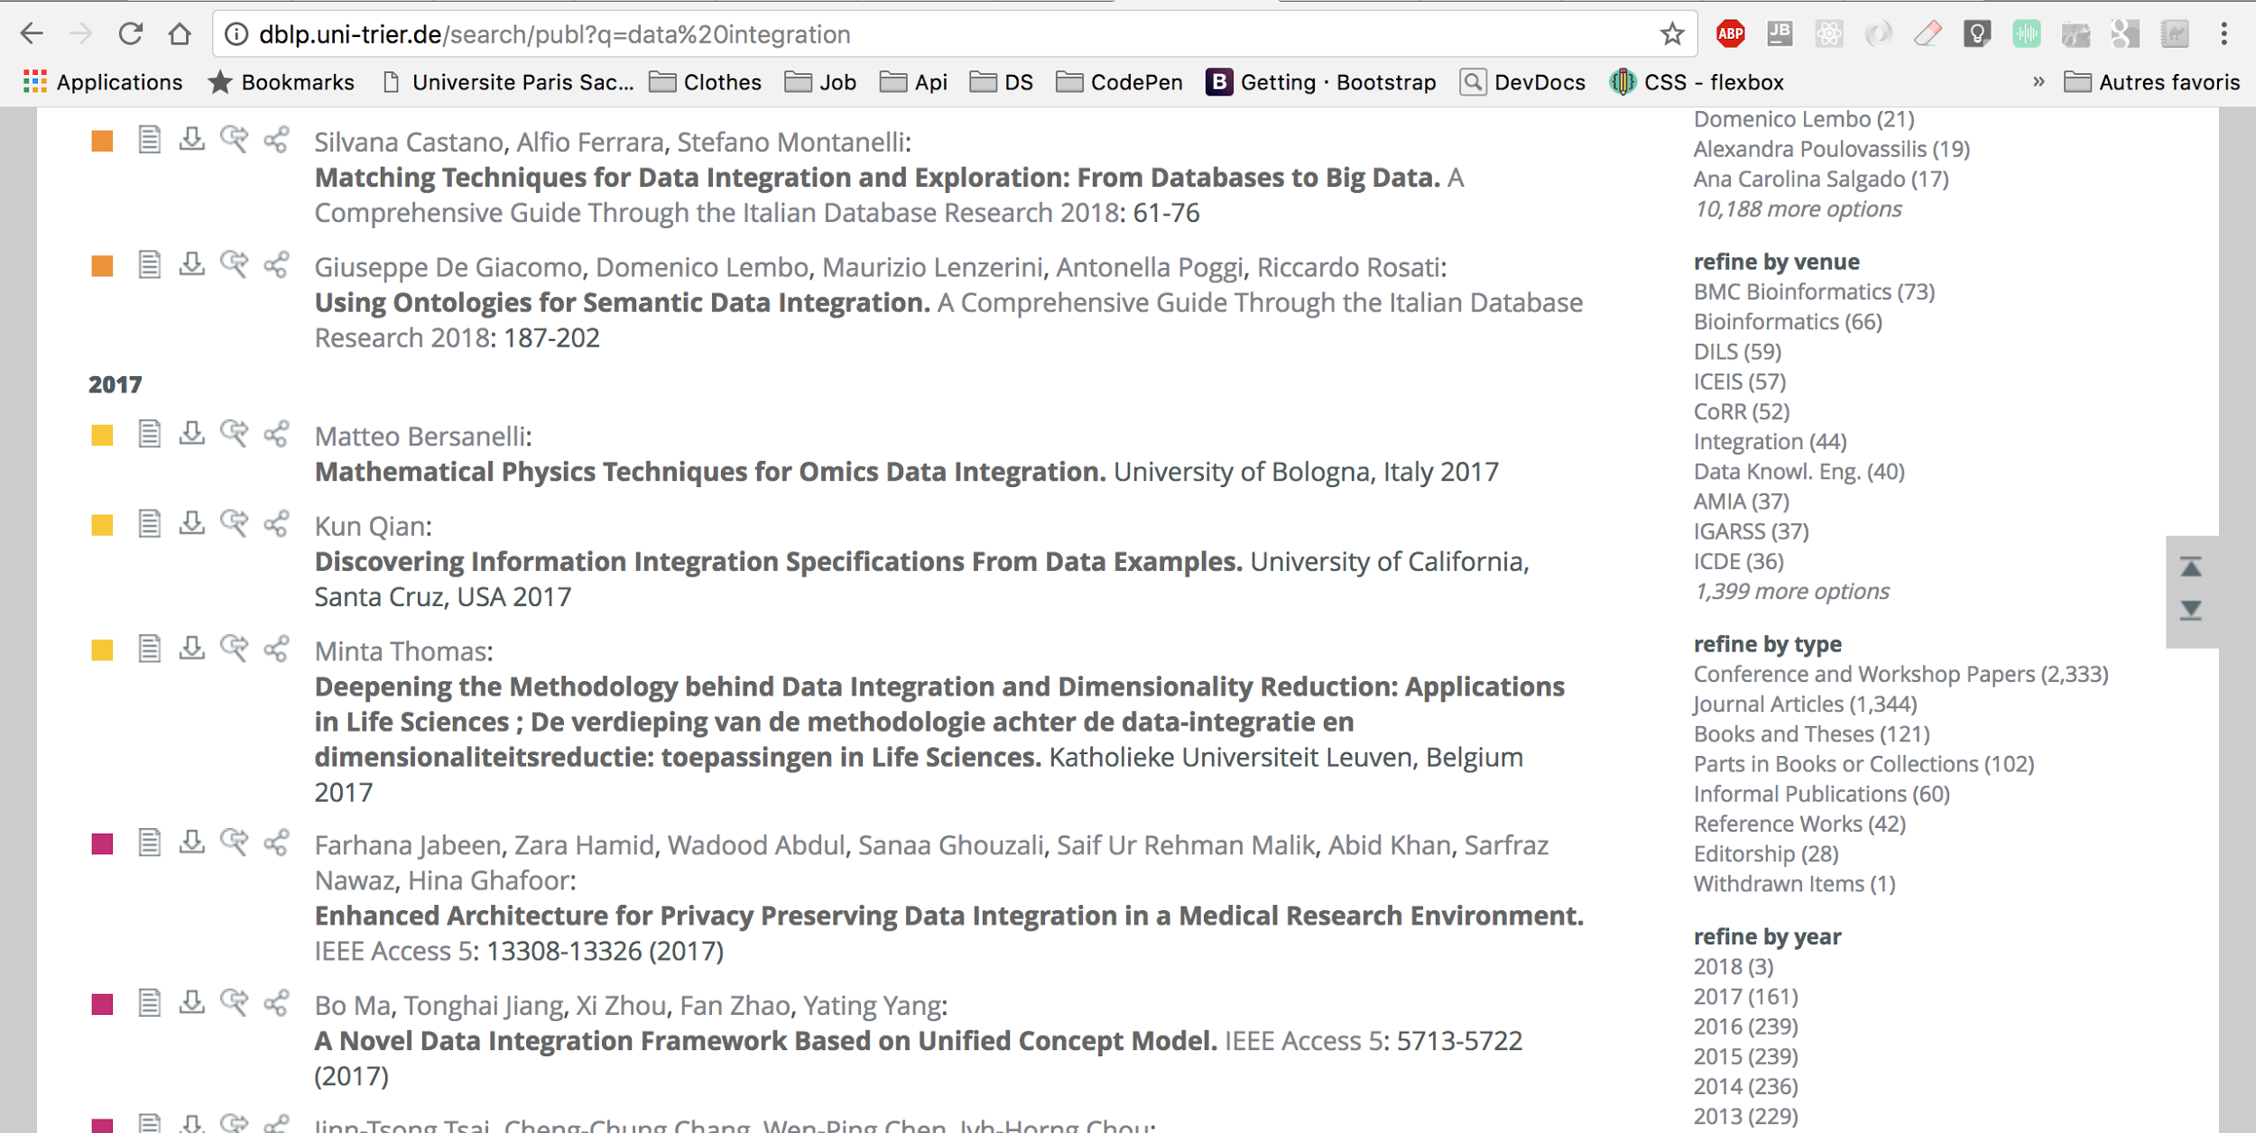
Manual Search
Notes:
Here we have a sample page of dblp website, we show you this example because this website is going to search on several website such as IEEE
And as you can see the research is about data integration
We have some parameters on the right
Type of document and date

Slide 8
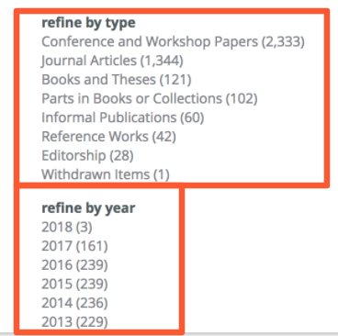
Manual Search
What’s missing ?
We miss this :
Related keywords
Database, image
We have this :
University informations
Tokyo, Japan
BUT ...
Type of author
Researcher
Interval of dates
1990’s
Notes:
We have type of documents and the year
But we miss relevant data to be able to answer to this question
First related keywords ⇒ for a given subject we want to have all related subjects to it
University ⇒
Author ⇒
Interval of dates ⇒

Slide 9
Automatic
Web Scraping
Help of a programming language
Go to given URL
Access DOM elements
Parse
Filter
Save for later
Notes:
The first automatic approach is Web scraping. This is how our approach would be, if we want to solve our problem with Web scraping, Let’s say we are using Python. We will manually search on the search bar “data integration save the link and go to it in our program. Link like www.ieee.explore..../search= something. We will get the json of the page and Since we know that every “Date, “Keyword” .. is a element of some specific class we will look if they are matching our conditions. If so we will save it.

Slide 10
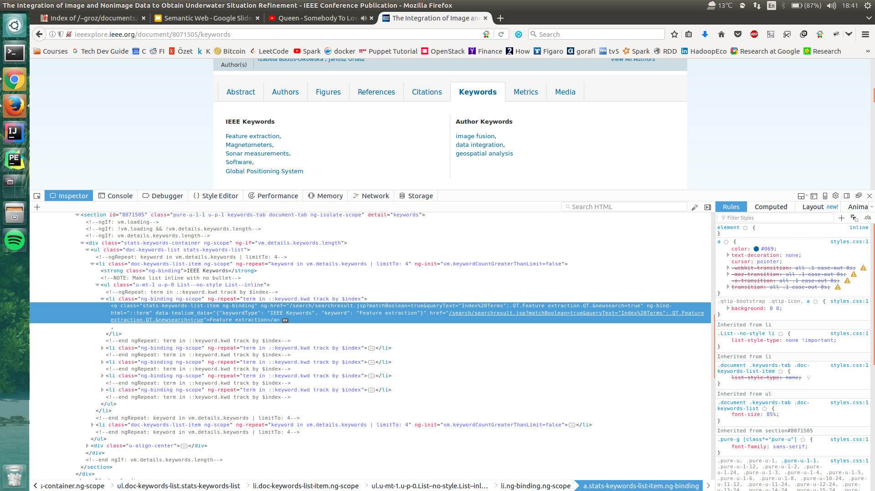
Automatic
Web Scraping
Notes:
I do not expect you to read this but I just wanted to show you how are the elements look like. Talk here maybe about map reduce

Slide 11

Automatic
Semantic approaches
Bring some relations between data!!
Notes:
AMIN

Slide 12
Automatic
Semantic approaches
General algorithm
for each document "d" and university "u":
# def store(knowledge, array) function storing knowledge into array
storeIf(hasType(d, article) ^ hasUniversity(d, u) ^ hasUniversityCountry(u, Japan)
^ hasSubject(d,data+integration) ^ hasAuthor(d, auth)
^ isResearcher(auth, researcher)
^ hasYear(d,1990's), knowledgeArray)
End for
Notes:
AMIN

Slide 13
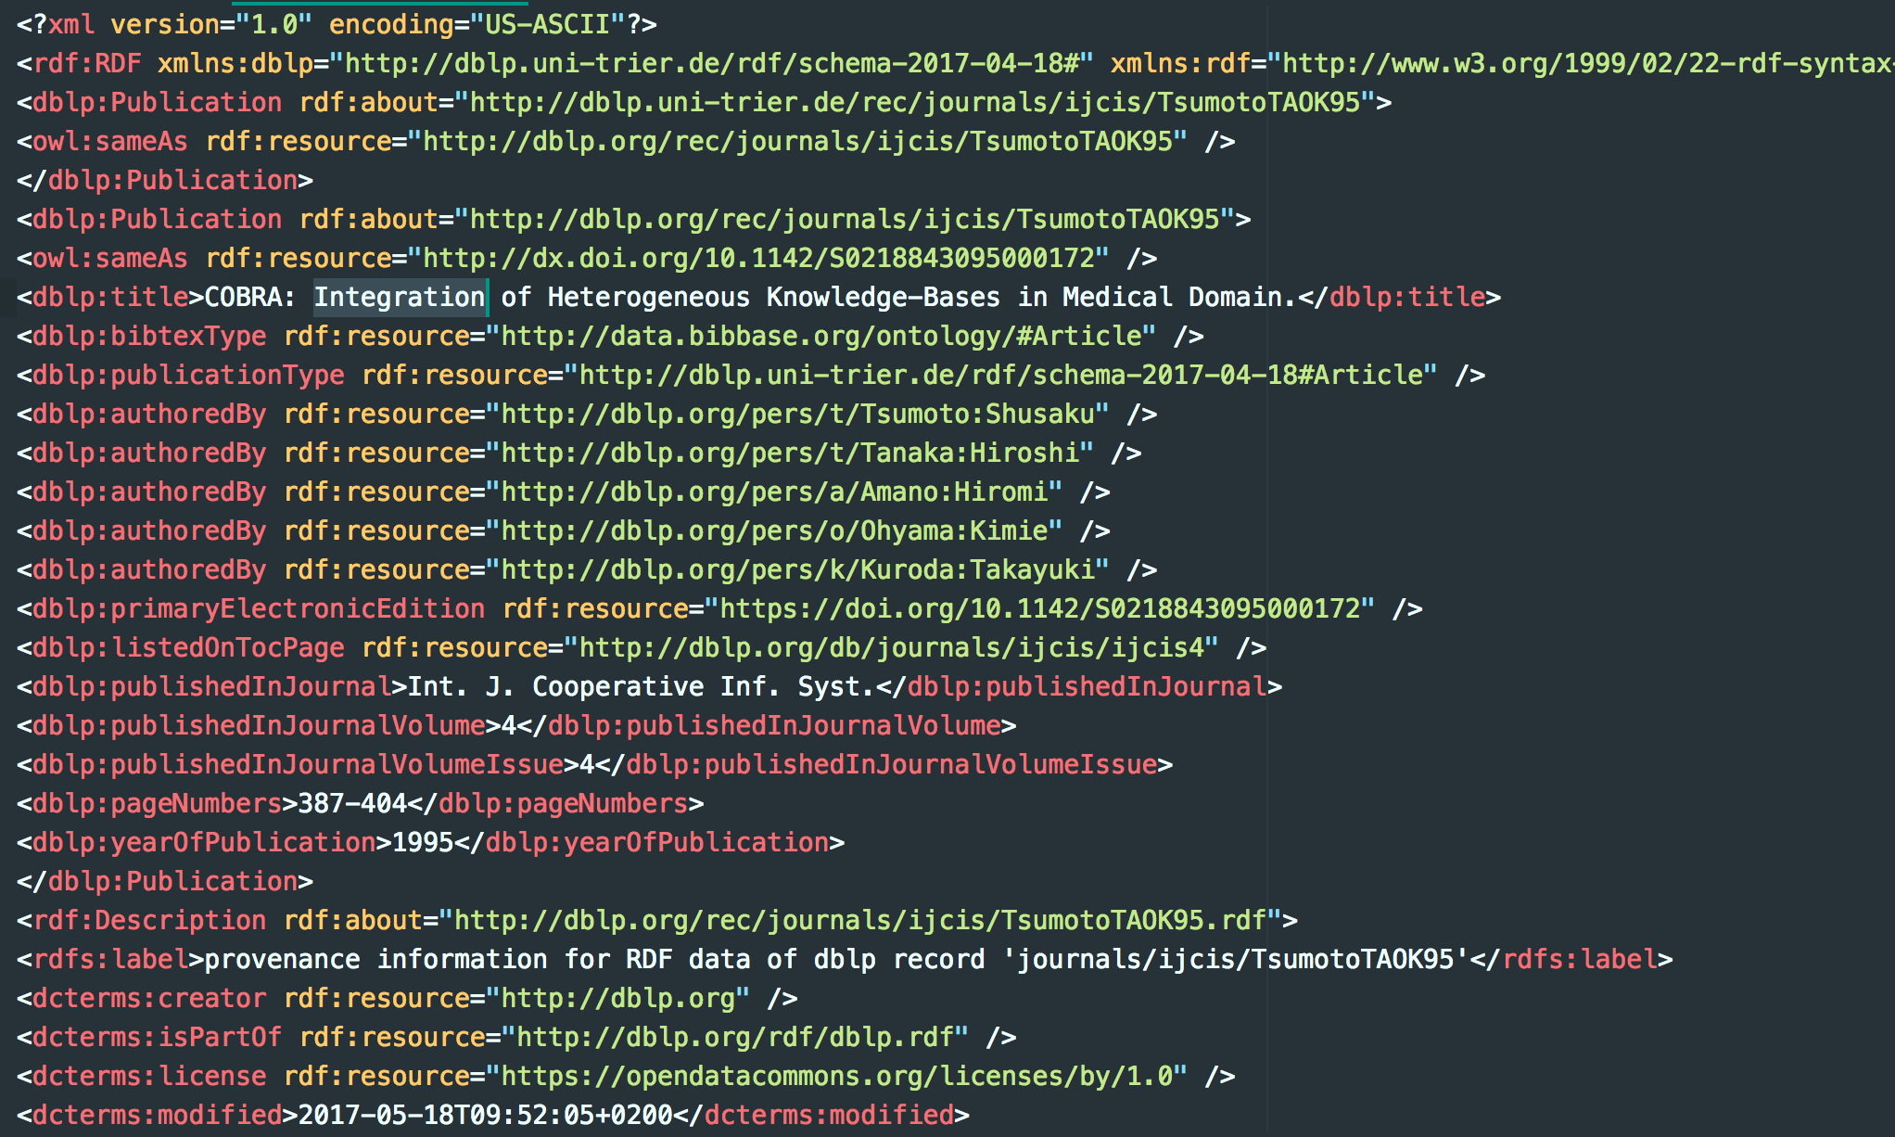
Automatic
Semantic approaches
Semantic Approach
RDF and Ontology
Custom
RDF
...
Notes:
AMIN

Slide 14
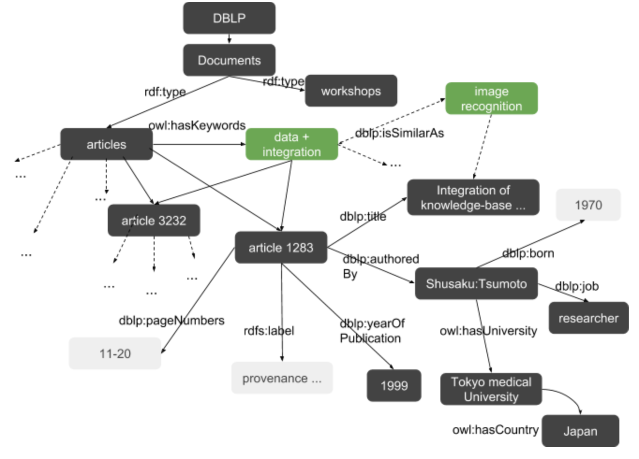
RDF
Customized
subject
keywords
relevant nodes
irrelevant nodes
Notes:
AMIN
Here to make it simple we have merge data and integration nodes But it should be 2 distinct ones

Slide 15
RDF Customized
def loopGraphOntology(Graph G, conditions):
# Our RDF rdfsemantic
rdfsemantic = new RDFSemantic()
for all nodes in G.getNodes():
for all document D inNodes.getDocumentsType():
# Take relevant data
relevantData = keepRelevant(D, conditions)
# if we found that it matches condition
if(relevantData != null):
# find key words related to this
kw = buildKeyWords(D)
# store RDF
rdfsemantic.pushRDFNode(kw,relevantData)
Store(rdfsemantic)
End

Slide 16
Results
Akihiko Takahashi, Masatoshi Ishikawa:
Signal processing architecture with bidimensional network topology for flexible sensor data integration system. IROS 1993: 407-413, Nat. Inst. of Biosci. & Human-technol., Tsukuba City, Japan
Atsuyuki Morishima, Hiroyuki Kitagawa:
InfoWeaver: Dynamic and Tailor-made Integration of Structured Documents, Web, and Databases. ACM DL 1999: 235-236, Institute of Information Sciences and Electronics, University of Tsukuba, Tennohdai, Tsukuba, Ibaraki 305-8573, Japan
Notes:
AMIN

Slide 17
Conclusion
Web Scraping | Semantic Approaches
Hard to implement (Need unique approaches for every web site) | Easier to implement
Could be Scalable (with SAX) | There might be some memory problems. for all nodes in G.getNodes()
Notes:
MERT AND AMIN

Slide 18
Sources
[1] Lectures of teacher Yue Ma, LRI
[2] CS 499/699 – Logic for Computer Scientists, Pascal Hitzler
http://daselab.cs.wright.edu/teaching/w11/2011-03-10-logic-02.pdf
[3] RDF graph of DBLP
https://old.datahub.io/dataset/l3s-dblp
[4] DBLP website
http://dblp.org/
[5] Demo
http://dblp.l3s.de/d2r/snorql/?describe=http%3A%2F%2Fdblp.l3s.de%2Fd2r%2Fresource%2Fpublications%2Fjournals%2F4or%2FAissi06
Notes:
MERT AND AMIN

Slide 19
Thank you !

Slide 20
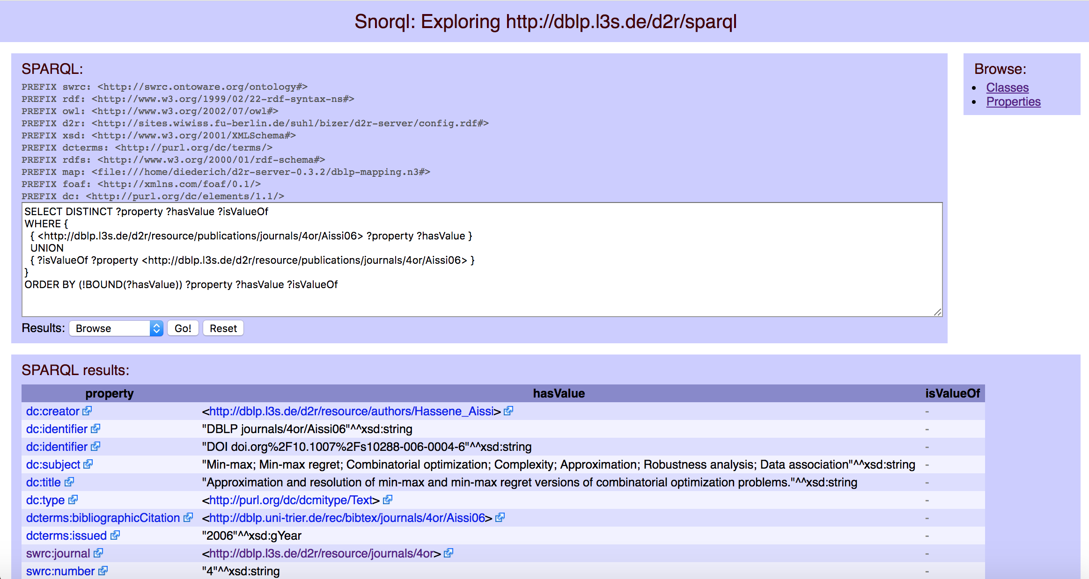
http://dblp.l3s.de/d2r/snorql/?describe=http%3A%2F%2Fdblp.l3s.de%2Fd2r%2Fresource%2Fpublications%2Fjournals%2F4or%2FAissi06
Notes:
If we have time show only picture

